Slide 1
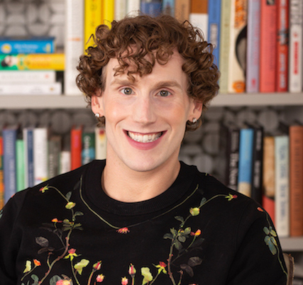
Why Stories Matter:
Vulnerability and Empowerment
in Queer Narratives
Moderator:
Dr. Shane A. McCoy (they/them/theirs)
General Education English Program Coordinator
Department of English
Affiliate Faculty Women’s and Gender Studies
Shane.McCoy@mtsu.edu
April 8, 2022

Slide 2
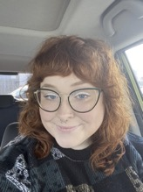
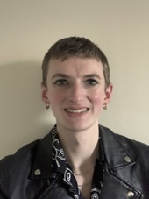
Lily Crawford (she/her/hers)
Lily Crawford is originally from Atlanta, Georgia. Since the Fall of 2018, she has lived in Murfreesboro and is currently studying Industrial/Organizational Psychology at MTSU. Her future plans include using her degree and all the opportunities she has had at MTSU to delve into queer literature to help make the workplace a better environment for everybody.
Nova Dieter (they/them/their)
Originally from Chattanooga, Tennessee, Nova Dieter (they/them) has lived in Murfreesboro for the past four years. Nova will be graduating in May with a Bachelor's degree in Fashion Merchandising. Nova explains that they have always found pleasure in empowering others to feel their most confident which has pushed Nova towards a career in retail management to help others express themselves.

Slide 3
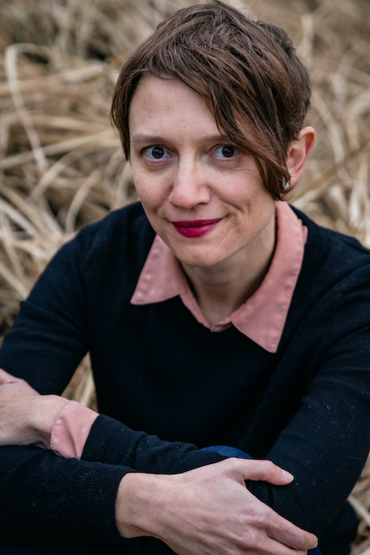
Amie Whittemore(she/her/hers)
Amie Whittemore is the author of the poetry collections Glass Harvest (Autumn House Press), Star-tent: A Triptych (Tolsun Books, 2023), and Nest of Matches (Autumn House, 2024). She was the 2020-2021 Poet Laureate of Murfreesboro, Tennessee, and an Academy of American Poets Laureate Fellow. Her poems have won multiple awards, including a Dorothy Sargent Rosenberg Prize, and her poems and prose have appeared in The Gettysburg Review, Nashville Review, Smartish Pace, Pleiades, and elsewhere. She is the Reviews Editor for Southern Indiana Review and teaches English at Middle Tennessee State University.

Slide 4
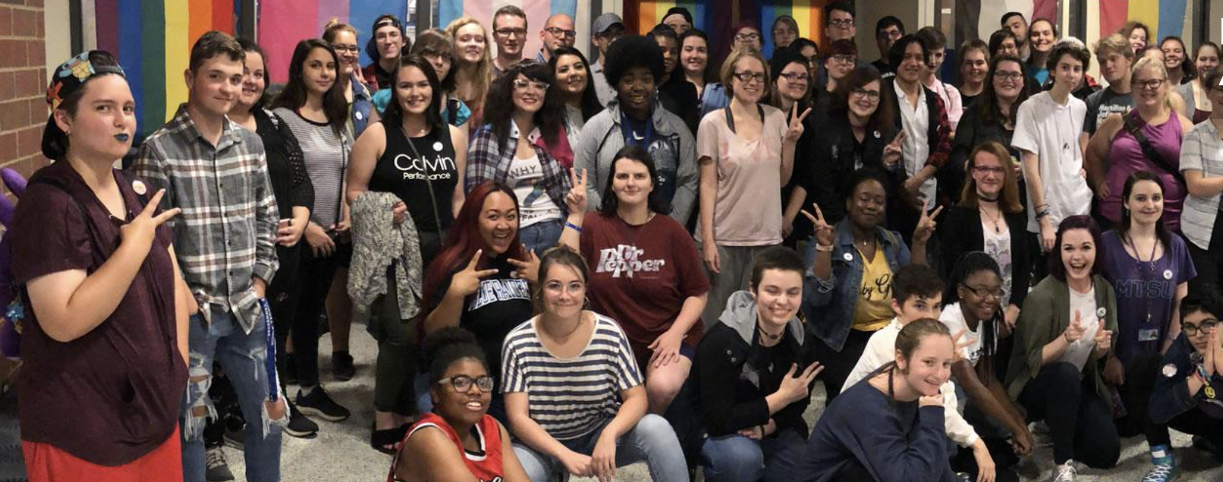
A Call to Action…
“[W]e can’t always ask our students to take off the armor at home, or even on their way to school, because their emotional and physical safety may require self-protection. But what we can do, and what we are ethically called to do, is to create a space in our schools and classrooms where all students can walk in and, for that day or hour, take off the crushing weight of their armor, hang it on a rack, and open their heart to truly being seen.”
—Brené Brown, Dare to Lead (p. 13, 2018)

Slide 5
I. Introduction to the Panel Theme
Vulnerability as a tool for empowerment in queer narratives– empowerment for both the storyteller and the recipient; why construction of the past matters (Clare Hemmings, Why Stories Matter: The Political Grammar of Feminist Theory)
How this shows up in life and work
Personal storytelling
Research and scholarship
Fiction and non-fiction
Poetry
C. Carries with it a constant negotiation of one’s identity
Being ‘out’ in the workplace
Being ‘out’ in educational settings
The role that vulnerability plays in this and the risks associated

Slide 6
Introduction Continued…
What has worked for you in particular?
How might university campuses such as MTSU’s cultivate LGBTQIA+ students’ sense of belonging and well-being?
Culturally Relevant Pedagogies (Geneva Gay, Gloria Ladson-Billings)
How might these challenges be navigated by faculty? (Martin et al. 2018)
Finally, what role might faculty play in facilitating LGBTQIA+ students’ sense of well-being and belonging? (Linley et al. 2016)
Linley et al., “Faculty As Sources of Support for LGBTQ College Students” (2016)-– research drawn from participants at an LGBTQ Conference

Slide 7
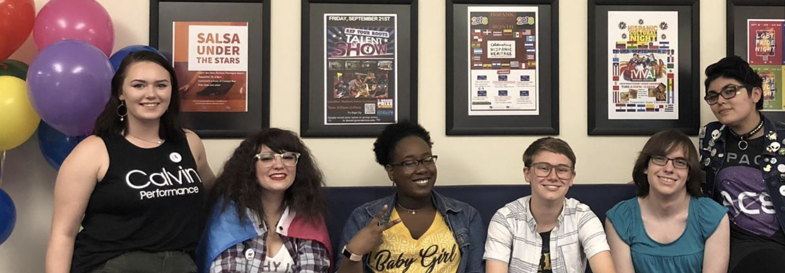
“Seeking social justice for LGBT people is not simply a matter of improving things for the immensely diverse group of individuals who identify with that label…Rather, it’s a matter of creating institutions that are more just for everyone– that eschew all types of discrimination, invite investment and engagement, and offer opportunities for everyone to succeed.”
– Kathryn Campbell, “Making Excellence Inclusive: Higher Education’s LGBTQ Contexts” (2012)

Slide 8
Reflection and Q&A

